Slide 1
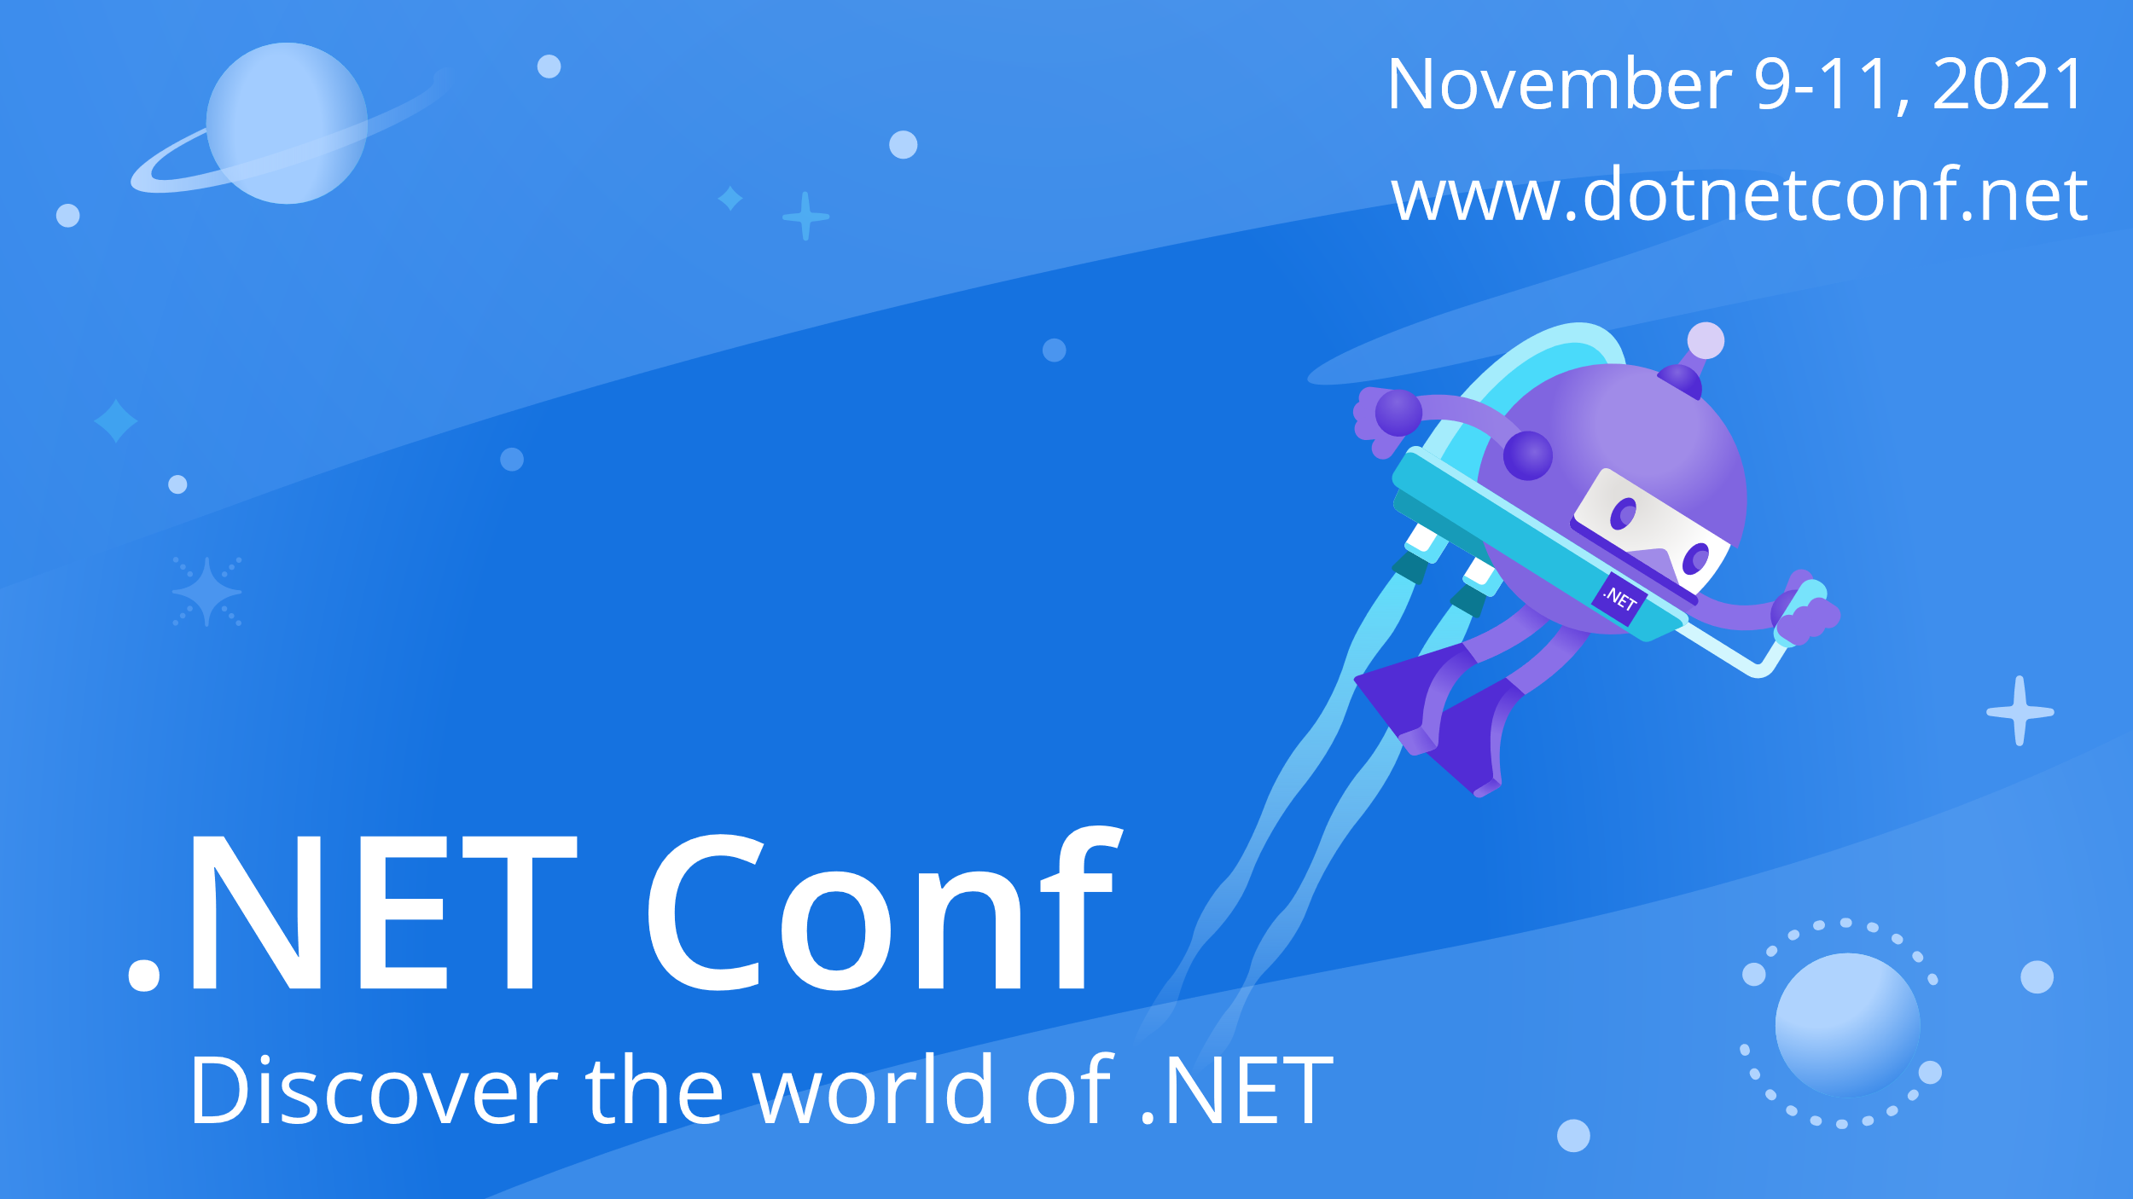

Slide 2


Creating Database-Agnostic Applications with EF Core
.NET Conf 2021
Shaun Walker
Nov 11, 2020
15:00 ET | 12:00 PT

Slide 3



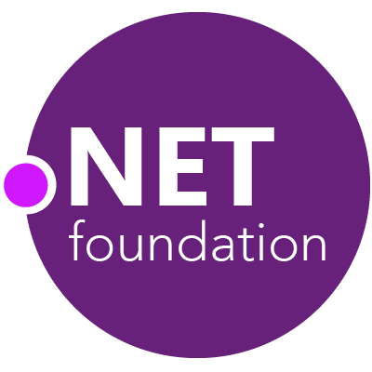

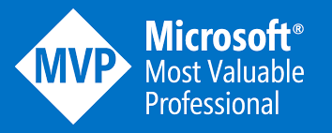


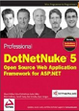
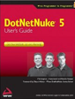



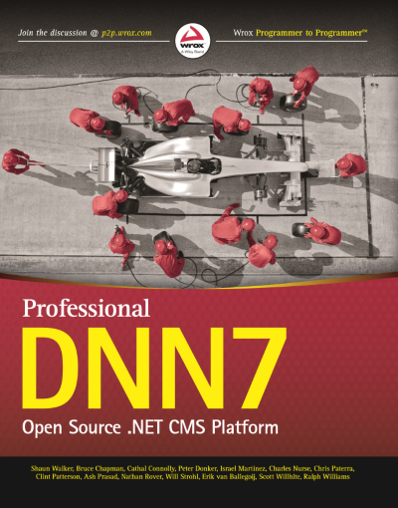

Shaun Walker
Creator of DotNetNuke
Microsoft MVP
ASP Insider
Creator of Oqtane
Chair of .NET Foundation Project Committee
CTO Professional Services
https://www.linkedin.com/in/shaunbrucewalker @sbwalker

Slide 4
Database Agnosticism
“Database-agnostic” is a term describing the capacity of software to be heterogeneous by supporting database management systems (DBMS) from multiple vendors.
Database-agnosticism is critical in providing cross platform support so that your software product can be used by the maximum number of customers regardless of their environmental preferences.
Database-agnostic software is also useful if a customer needs to support multiple environments with different database management systems in order to optimize resource allocation or licensing costs.

Slide 5
Database Popularity
MySQL
PostgreSQL
NoSQL
RDMS
SQLite
SQL Server

Slide 6
High Level Considerations
All interactions with the database must occur through a generic abstraction layer to enable the software to be written in a consistent manner without requiring any knowledge of the underlying database management system being utilized.
The abstraction layer needs to support all standard data access operations ( ie. create, read, update, delete )
The abstraction layer needs to support provisioning ( ie. creating/modifying database schema such as tables, indexes, keys during installation, as well as facilitating upgrades for new software versions )

Slide 7
EF Core Capabilities
EF Core was developed with cross platform capabilities so that it could satisfy the cross platform goals of .NET Core
EF Core makes it straightforward to develop applications that support a single database management system
Supporting multiple database management systems in the same application is a much more complex scenario
Luckily EF Core was designed with extensibility in mind which allows it to accommodate additional scenarios

Slide 8
EF Core Concepts
Data Access | Provisioning
A light-weight object-relational mapper (ORM) which enables .NET developers to work with a database using .NET objects and eliminates the need for most of the data-access code that typically needs to be written. Data access is performed using a model. A model is made up of entity classes and a context object that represents a session with the database. The context object allows querying and saving data. | Migrations provide a way to incrementally update a database schema to keep it in sync with the application's data model while preserving existing data in the database. Migration classes are code files which contain commands for creating or modifying a database schema. The commands are based on an abstraction layer to shield the developer from the details of the underlying DBMS.

Slide 9

A Modular Application Framework for Blazor

Slide 10

Oqtane Framework
Multi-Tenant
Web UI Framework
Granular Permissions
Admin User Interface
Dynamic Routing
Modular Architecture
Customizable Themes
Headless API & Multi-DB
“Rocket Fuel for Blazor”

Slide 11
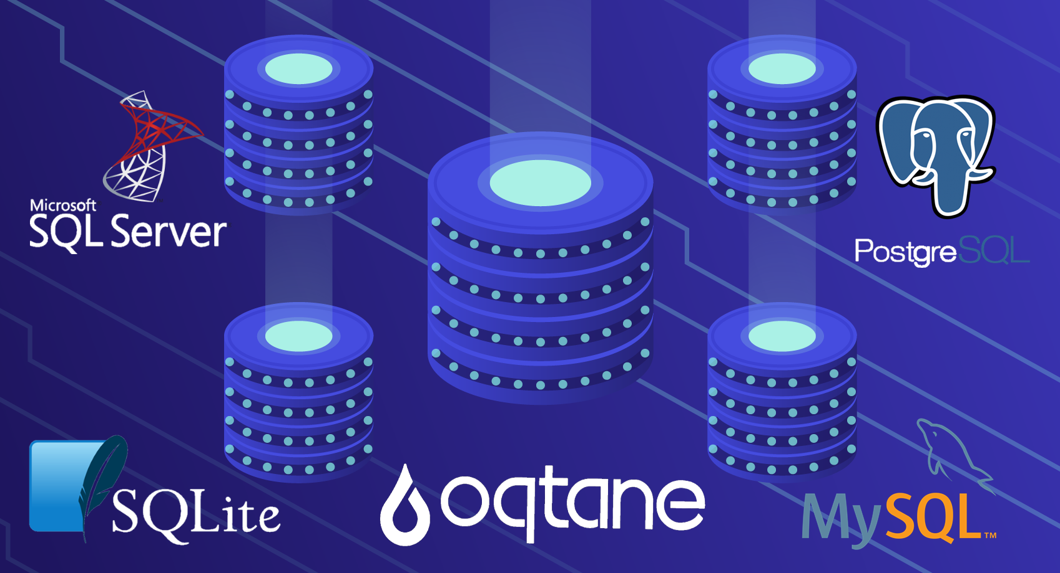

Slide 12
Oqtane Database Requirements
Multi-Tenant – must support both isolated and shared tenancy models within the same installation
Modular – database providers must developed and installed independently from core framework
Extensible – needs to support the needs of the core framework as well as external module developers
Run-time Deployment – must provide native support for non-developers to install the framework and modules without them requiring technical knowledge or other tools
Optimized – only load database providers which are required

Slide 13
Demo

Slide 14
Oqtane Database Providers
Oqtane Database Provider
Client
User interface component allowing an end user to provide specific configuration options for connecting to a database
(ControlType)
"AvailableDatabases": [
{
"Name": "SQL Server",
"ControlType": "Oqtane.Installer.Controls.SqlServerConfig, Oqtane.Client",
"DBType": "Oqtane.Database.SqlServer.SqlServerDatabase, Oqtane.Database.SqlServer"
},
{
"Name": "SQLite",
"ControlType": "Oqtane.Installer.Controls.SqliteConfig, Oqtane.Client",
"DBType": "Oqtane.Database.Sqlite.SqliteDatabase, Oqtane.Database.Sqlite"
}
]
Server
A concrete implementation for the generic abstraction which allows the application to interact with the specific database
(DBType)

Slide 15
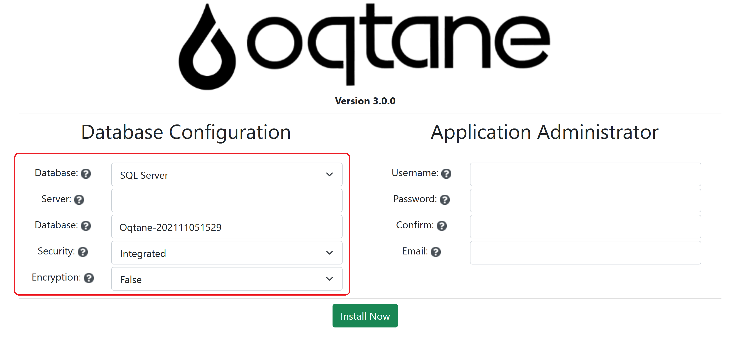
Client Database Provider
Control Type defines the type name of the razor component to dynamically create
Implements IDatabaseConfigControl
Dynamically injected into user interface based on database selected
Responsible for its own defaults and validation
Returns a connection string

Slide 16
Server Database Provider
DBType defines the type name of the class to dynamically create
Database providers are derived from DatabaseBase which inherits from IDatabase
IDatabase defines the contract for the base functionality which all database providers must support
Generally this includes any operation which may require database-specific configuration ie.
DbContextOptionsBuilder.UseDatabase() - startup
AddAutoIncrementColumn() - migrations
ExecuteQuery() – primitive SQL commands
Also extends Migration History table with additional fields

Slide 17

Database Provider Packages
Individually packaged as Nuget packages
Nuget package includes all database specific dependencies
Nuget package is installed and loaded dynamically at run-time based on user preference
Distributed in Oqtane.Server\Packages folder
Oqtane.Database.SqlServer.nupkg
Oqtane.Database.Sqlite.nupkg
Oqtane.Database.MySQL.nupkg
Oqtane.Database.PostgreSQL.nupkg

Slide 18
Framework Support
BaseEntityBuilder – provides simplified properties and methods for implementing migration logic
MultiDatabaseMigration – extends MigrationBuilder to provide support for multiple databases – critical for multi-tenancy
protected override AliasEntityBuilder BuildTable(ColumnsBuilder table)
{
AliasId = AddAutoIncrementColumn(table,"AliasId");
Name = AddStringColumn(table, "Name", 200);
TenantId = AddIntegerColumn(table, "TenantId");
SiteId = AddIntegerColumn(table, "SiteId");
return this;
}
protected override void Up(MigrationBuilder migrationBuilder)
{
var siteEntityBuilder = new SiteEntityBuilder(migrationBuilder, ActiveDatabase);
siteEntityBuilder.AddStringColumn("Runtime", 50, true, true);
siteEntityBuilder.UpdateColumn("Runtime", "'Server'");
}

Slide 19
Challenges
.NET Core CLI Tools used for generating migration source files by comparing the current model against a snapshot of the old model to determine the differences only supports simplistic DBContext scenarios – not multi-tenancy
Avoiding usage of SQL is difficult as there are often migration scenarios which require updating data
PostgreSQL uses snake casing for all database object names
SQL Server, SQLite, and MySQL do not natively support a Boolean data type, however PostgreSQL does
Debugging database migration issues can be challenging

Slide 20
Oqtane 3.0
Migrated to .NET 6
Blazor hosting model flexibility per Site
Blazor WebAssembly Prerendering support
Upgraded to Bootstrap 5
and much more…
https://github.com/oqtane/oqtane.framework

Slide 21

Charles Nurse
Former Chief Architect DNN Corp
Microsoft MVP
ASP Insider
Responsible for the implementation of multiple database support in Oqtane

Slide 22

Thanks for joining!

